Slide 1
Mocha Raspberry Pi Hacking
Stephen Chin (@steveonjava)

Slide 2
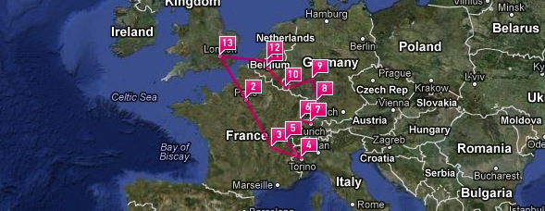
NightHacking Tour
-- The Road to Devoxx --
Oct 29 to Nov 11
nighthacking.com

Slide 3
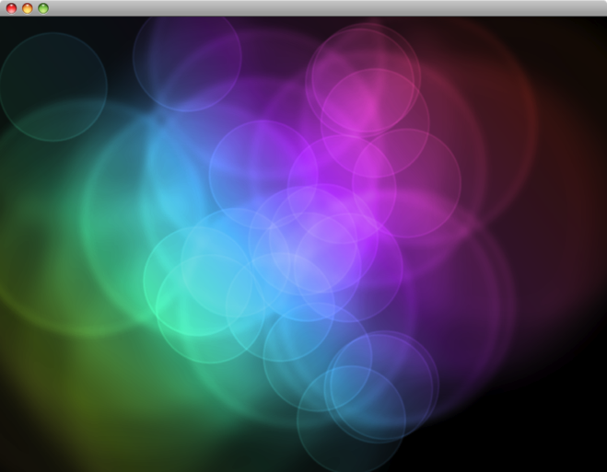
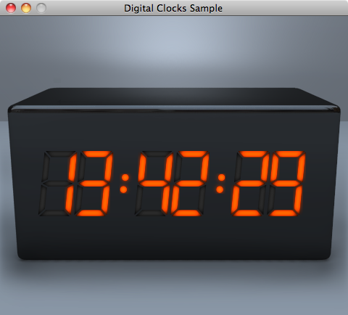
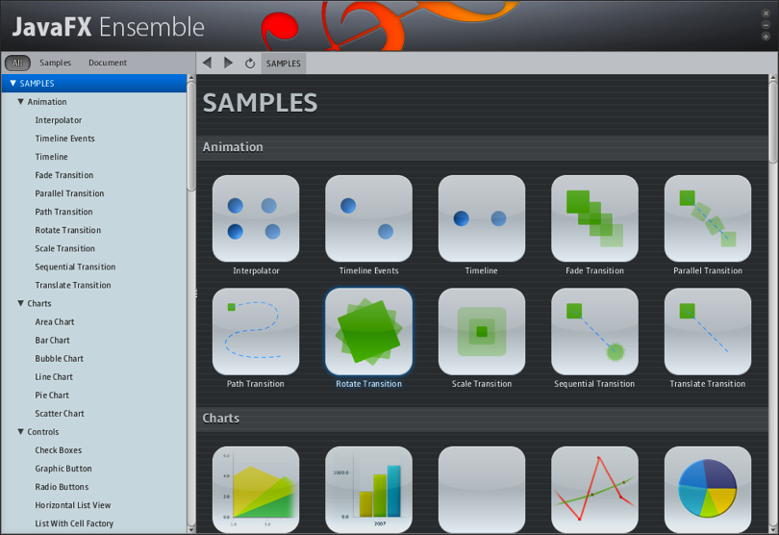
JavaFX 2.0 Platform
Immersive Application Experience
Cross-platform Animation, Video, Charting
Integrate Java, JavaScript, and HTML5 in the same application
New graphics stack takes advantage of hardware acceleration for 2D and 3D applications

Slide 4
How to Get JavaFX
Step 1: Download Java 7

Slide 5
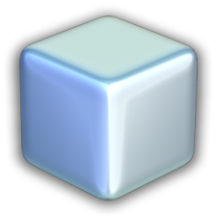
How to Develop JavaFX
Use Your Favorite IDE

Slide 6
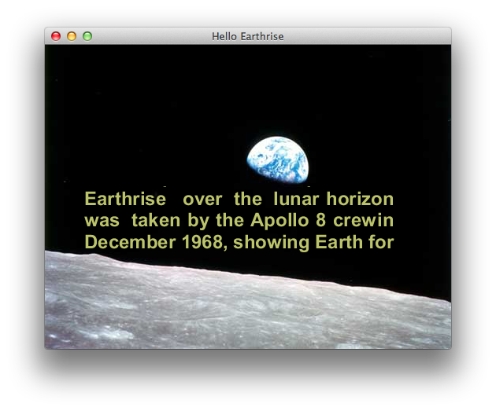
Your First JavaFX Application
Hello Earthrise

Slide 7
JavaFX Embedded Dev Preview
BeagleBoard

Slide 8
Have JavaFX With Your Dessert
Raspberry Pi

Slide 9
Build Applications Visually
JavaFX Scene Builder

Slide 10
Package Your Application
Applets, Web Start, and Native Packaging
Good
Better
Best

Slide 11
And Ensemble is the First App in The Store!

Slide 12
And you can do cool stuff like this…

Slide 13
Conclusion
JavaFX enables graphically rich, fast performing apps
Deploy via the browser, web start, or native packaging
Visually create applications using Scene Builder
Run on BeagleBoard today
Raspberry Pi coming soon!

Slide 14
The preceding is intended to outline our general product direction. It is intended for information purposes only, and may not be incorporated into any contract. It is not a commitment to deliver any material, code, or functionality, and should not be relied upon in making purchasing decisions. The development, release, and timing of any features or functionality described for Oracle’s products remains at the sole discretion of Oracle.

Slide 15
NightHacking Tour
-- The Road to Devoxx --
Stephen Chin
tweet: @steveonjava
Oct 29 to Nov 11
nighthacking.com

